Slide 1
SAGA: sequence alignment by genetic algorithm
Cédric Notredame and Desmond G. Higgins
Nucleic Acids Research, Vol. 24, No. 8, pp.1515–1524, 1996
Date: Mar. 26, 2008
Introducer: Chung-Han Chiang

Slide 2
Abstract
We describe a new approach to multiple sequence alignment using genetic algorithms and an associated software package called SAGA. The method involves evolving a population of alignments in a quasi evolutionary manner and gradually improving the fitness of the population as measured by an objective function which measures multiple alignment quality. SAGA uses an automatic scheduling scheme to control the usage of 22 different operators for combining alignments or mutating them between generations. When used to optimise the well known sums of pairs objective function, SAGA performs better than some of the widely used alternative packages. This is seen with respect to the ability to achieve an optimal solution and with regard to the accuracy of alignment by comparison with reference alignments based on sequences of known tertiary structure. The general attraction of the approach is the ability to optimise any objective function that one can invent.

Slide 3
Input & Output
Input: a set of sequences
Output: globally optimal multiple alignments

Slide 4
Introduction
Sequence Alignment Problemcs
Definition:
  Input: Two (or more) sequences S₁, S₂, …, S_{n}, and a scoring function f.
  Output: The alignment of S₁, S₂, …, S_{n}, which has the optimal score.
Example： S₁ = TAGTCACG , S₂ = AGACTGTC
⇒
----TAGTCACG TAGTCAC-G--
AGACT-GTC--- -AG--ACTGTC

Slide 5
Genetic Algorithm (GA)
Definition: A genetic algorithm (GA) is a search technique used in computing to find exact or approximate solutions to optimization and search problems. Genetic algorithms are categorized as global search heuristics.

Slide 6
1. Choose initial population
2. Evaluate the fitness of each individual in the population
3. Repeat
1. Select best-ranking individuals to reproduce
2. Breed new generation through crossover and mutation (genetic operations) and give birth to offspring
3. Evaluate the individual fitnesses of the offspring
4. Replace worst ranked part of population with offspring
4. Until termination

Slide 7
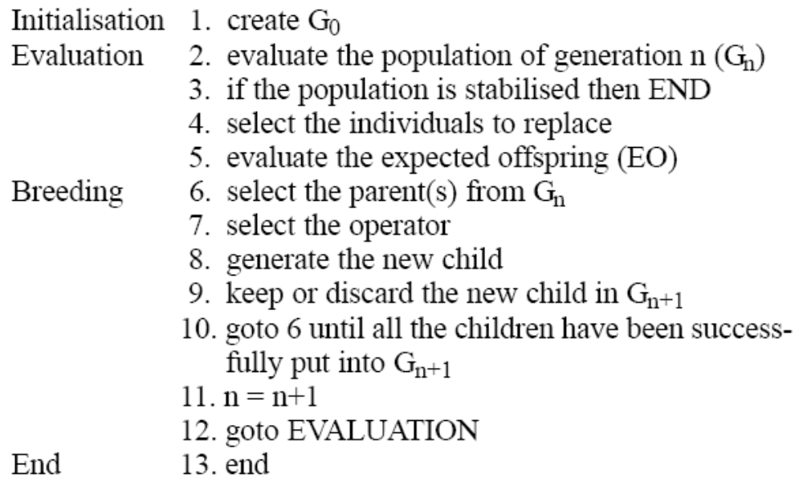
Algorithm

Slide 8
Initialisation: a random offset is chosen for all sequences,
and each sequence is moved to the right,
according to its offset. The sequences are
then padded with null signs in order to have
the same length.
Null signs
S₁
S₂
Sequence
S₃
S_{k}
Evaluation: This fitness is assessed by scoring each alignment
according to the OF. The better the alignment,
the better its score, and thus the higher its fitness.

Slide 9
Breeding: To modify the parent(s), an operator has to be
chosen. An operator is a small program that will
modify an alignment (e.g. shuffle the gaps or merge
two alignments into a new one).
In the same generation, all the alignments have to
be different. This technique helps maintain a high
level of diversity in a population of small size.
End: SAGA is stopped when the search has been unable to
improve for some specified number of generations. This
condition is the most widely used when working on a
population with no duplicates.

Slide 10
The operator - Crossovers
Crossover: two different types of crossover: one-point and uniform.
MGMUK---VDEVGGEAL-
MCMUKEKE---VGGEAL–
MCMUG--AMAGKYGAEAL
MGMUGGM A--GEYGAEAL
--WGKVKVDEVC-CEAL
WD--KVNEEEVG–GEAL
WQXVDA-HAGEYGA EAL
WSKVDGHAGE-YGA EAL
+
one-point crossover
MGMU--KVDEVC-CEAL
MCMU--NEEEVG-GEAL
MCMUDA-HAGEYGA EAL
MGMUDGHAGE-YGAEAL
--WGKVK---VDEVGGEAL-
WD--KVKEKE---VGGEAL–
WQXV --G--AMAGKYGAEAL
WSKV --GGM A--GEYGAEAL
Better one would be kept.

Slide 11
MGUK---VDEVG G EAL-
MCUKEKE---VG G EAL–
MCUG--AMAGKY G AEAL
MGUGGM A--GEY G AEAL
--WGUVKVDEV G -CEAL
WD--UVNEEEV G –GEAL
WQXV UA-HAGEG YA EAL
WSKV UGHAGE-G YA EAL
uniform crossover
MGU VKVDEV G EAL-
MCU VNEEEV G EAL-
MCU A-HAGEG AEAL
MGU GHAGE-G AEAL

Slide 12
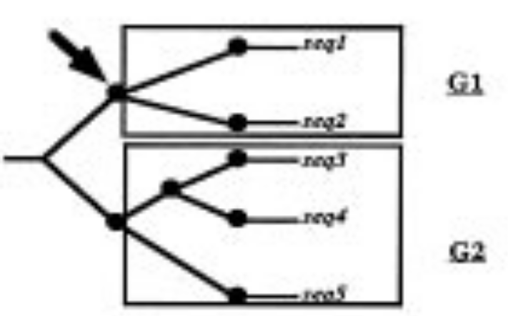
The operator - Gap insertion
P1
P2
G1
Seq1: WGKYNVDEVGGKA-GL
Seq2: WDKYNNEEVGGKA-GL
Seq3: W-KYQAHAQEYQAEAL
Seq4: W-KYGAHAQEYGAEAL
Seq5: W-KYKAHAGEYQQDIL
WGKY--NVDEVGGKA-GL
WDKY--NNEEVGGKA-GL
W-KYQAHAQEYQAEAL--
W-KYGAHAQEYGAEAL--
W-KYKAHAGEYQQDIL--
G2

Slide 13
The operator - Block shuffling
WGKVY--NDEVGGKA
WA--KYQAHAQEYQA
WAKYGAHAQEYGAEAL-
WQKYKAHAGEYQQDIL-
WGKVY--NDEVGGKA
WA-KY-QAHAQEYQA
WAKYGAHAQEYGAEAL-
WQKYKAHAGEYQQDIL-
Split a part of blocks and move one half to the left or to the right.
WGKV--YNDEVGGKA
W--AKYQAHAQEYQA
WAKYGAHAQEYGAEAL-
WQKYKAHAGEYQQDIL-
WG--KVYNDEVGGKA
WA--KYQAHAQEYQA
WAKYGAHAQEYGAEAL-
WQKYKAHAGEYQQDIL-
Moving the full block of gaps.
Moving a part of blocks (according to the tree).

Slide 14
Dynamic scheduling of the operators
MGMUK---VDEVGGEAL-
MCMUKEKE---VGGEAL–
MCMUG--AMAGKYGAEAL
MGMUGGM A--GEYGAEAL
--WGKVKVDEVC-CEAL
WD--KVNEEEVG–GEAL
WQXVDA-HAGEYGA EAL
WSKVDGHAGE-YGA EAL
+
one-point
uniform
Gap insertion
Block shuffling
10 generation
10% 25% 25% 40%
15% 40% 15% 30%
MGMU--KVDEVC-CEAL
MCMU--NEEEVG-GEAL
MCMUDA-HAGEYGA EAL
MGMUDGHAGE-YGAEAL
--WGKVK---VDEVGGEAL-
WD--KVKEKE---VGGEAL–
WQXV--G--AMAGKYGAEAL
WSKV--GGM A--GEYGAEAL

Slide 15
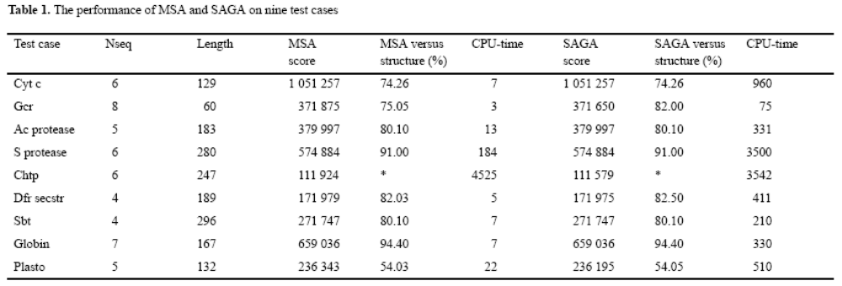
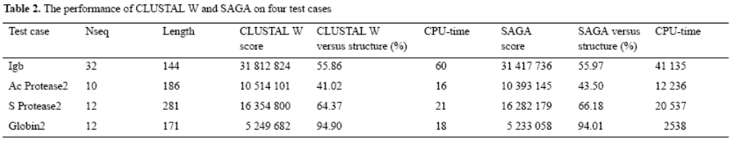
Results

